Slide 1
The “Small Class Feel” And Increasing Enrollment
Using Blended Classroom Techniques To Maximize Efficacy
Jossalyn Larson, Ph.D
larsonjo@mst.edu

Slide 5
Notes:
In March 2015, for example, the Conference on College Composition and Communication (CCCC)’s Principles and Standards were revised to suggest that the ideal writing classroom should be capped at 15 students, and writing instructors should teach no more than 60 students per term; yet because first year writing courses service nearly every student on campus, most writing classrooms are capped between 20 and 25 students, and teaching professors generally instruct between 80 and 100 students each semester.

Slide 6
1 page of feedback per week
16 weeks per semester
80-100 students per semester
Approx. 150 pages of feedback per week
Approx. 2400 pages of weekly feedback per semester
Plus four essays, totaling approx. 30 pages per student = 2700 pages
5,100 pages of annotation per semester
10, 200 pages of annotation per year
Notes:
In March 2015, for example, the Conference on College Composition and Communication (CCCC)’s Principles and Standards were revised to suggest that the ideal writing classroom should be capped at 15 students, and writing instructors should teach no more than 60 students per term; yet because first year writing courses service nearly every student on campus, most writing classrooms are capped between 20 and 25 students, and teaching professors generally instruct between 80 and 100 students each semester.

Slide 7
Objectives
Increase faculty-student interaction
Promote active learning
Improve attainment of learning outcomes
Improve student self-confidence

Slide 8
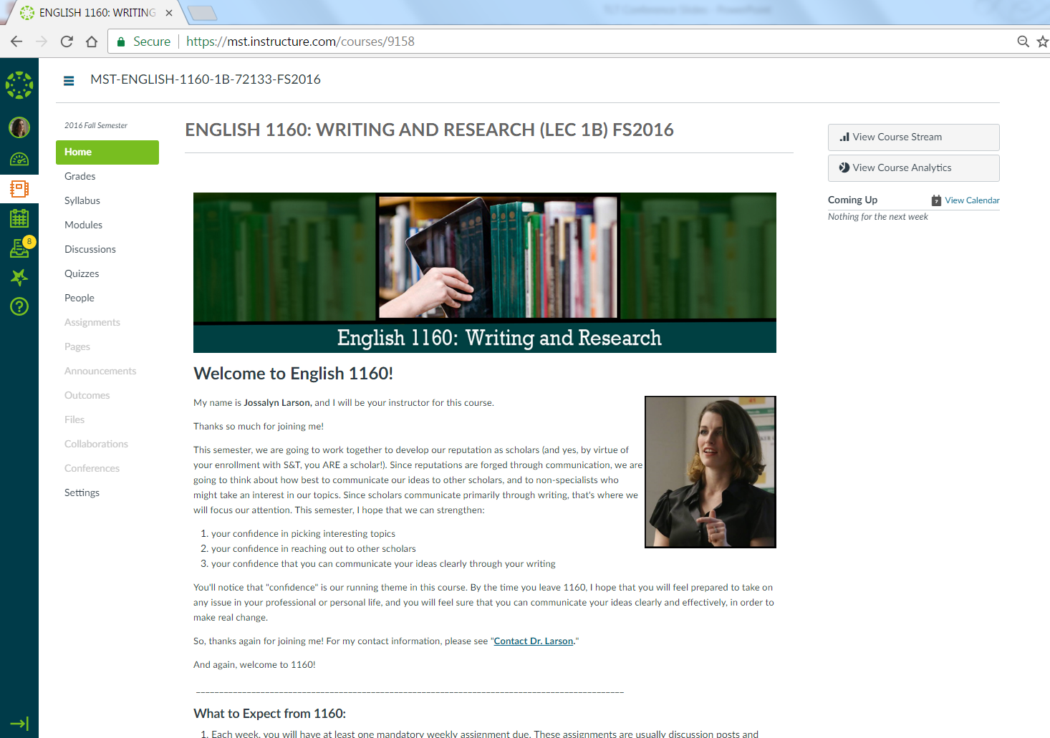
Notes:
In March 2015, for example, the Conference on College Composition and Communication (CCCC)’s Principles and Standards were revised to suggest that the ideal writing classroom should be capped at 15 students, and writing instructors should teach no more than 60 students per term; yet because first year writing courses service nearly every student on campus, most writing classrooms are capped between 20 and 25 students, and teaching professors generally instruct between 80 and 100 students each semester.

Slide 9
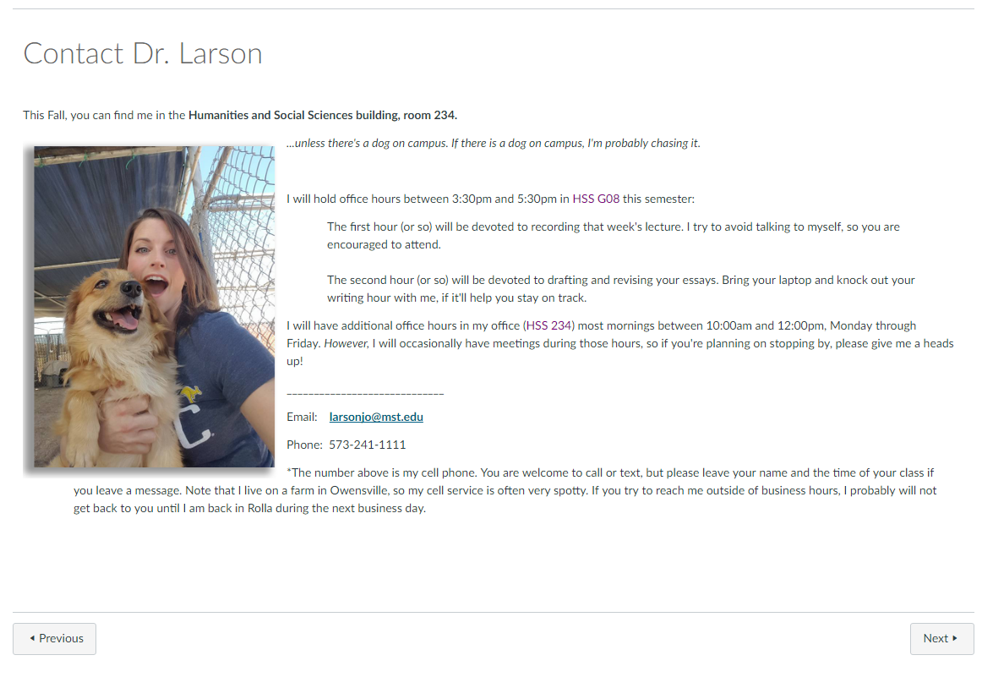

Slide 10
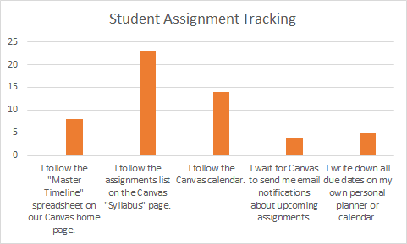

Slide 12
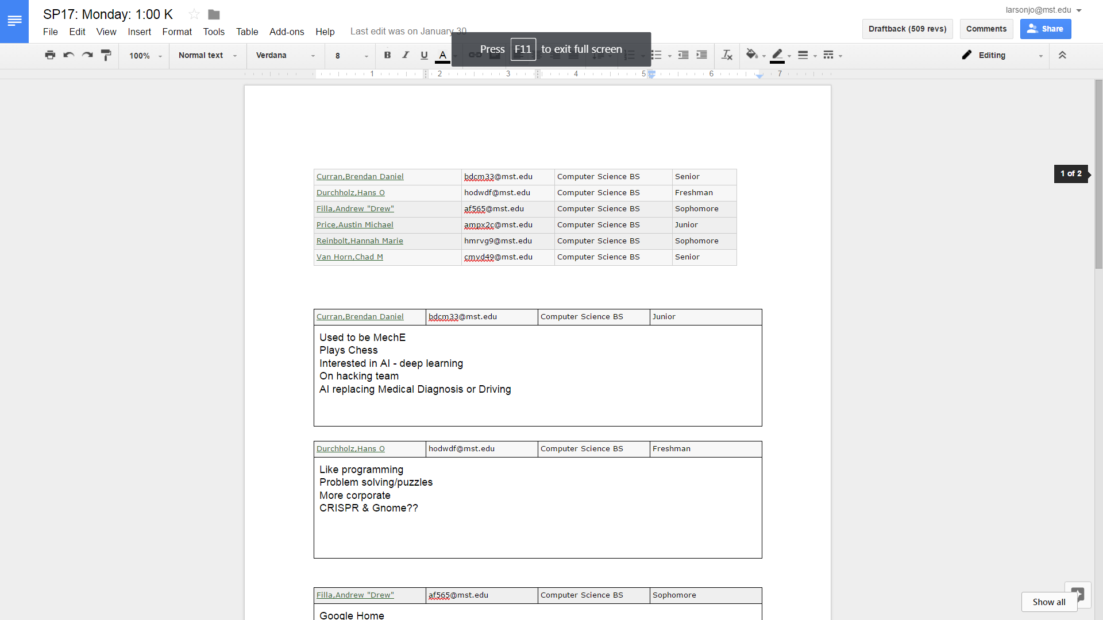

Slide 13
The Pilot
Case Study: Section 1D
 | Spring 2015 | Fall 2016
Avg. Final Grade | 78.807 | 87.047
Median Grade | 84.47 | 85.85
Standard Dev. | 11.898 | 3.698

Slide 14
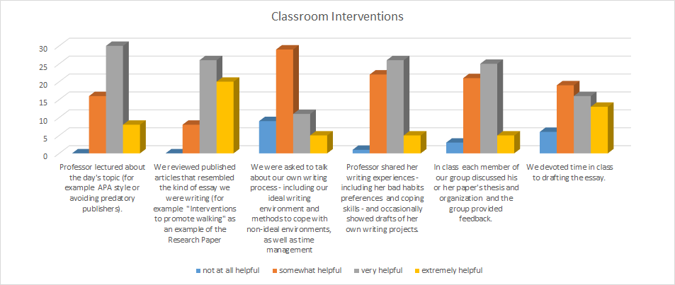

Slide 15
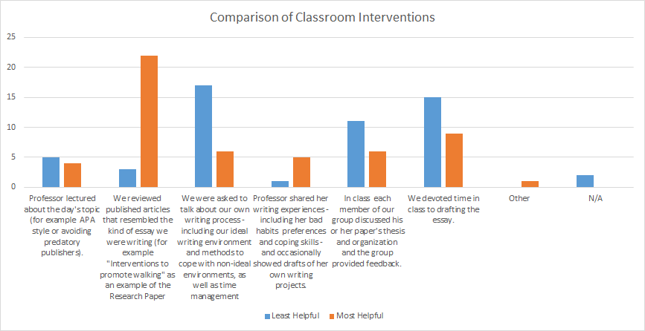

Slide 16
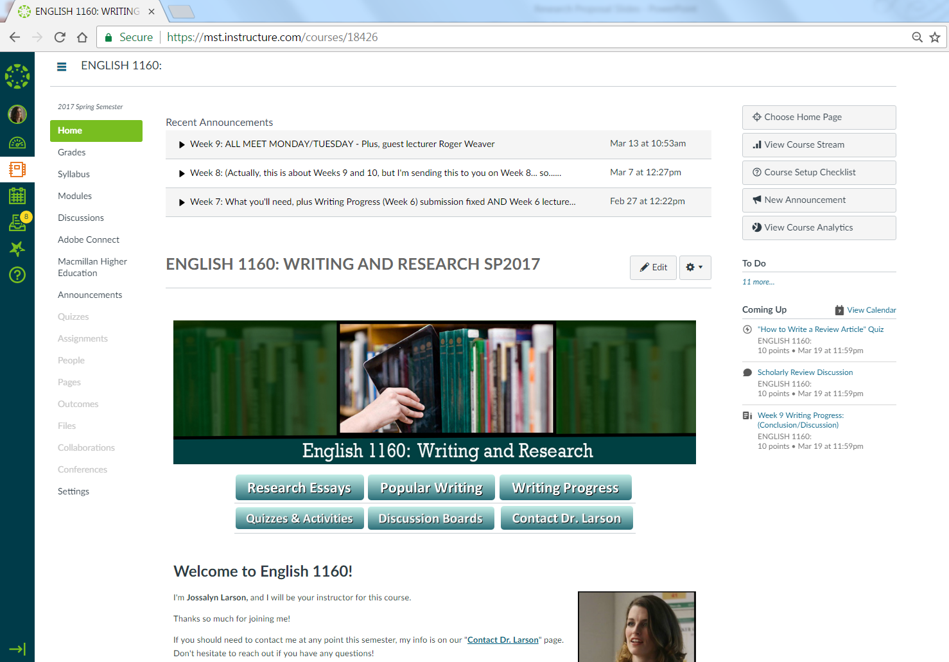
Notes:
In March 2015, for example, the Conference on College Composition and Communication (CCCC)’s Principles and Standards were revised to suggest that the ideal writing classroom should be capped at 15 students, and writing instructors should teach no more than 60 students per term; yet because first year writing courses service nearly every student on campus, most writing classrooms are capped between 20 and 25 students, and teaching professors generally instruct between 80 and 100 students each semester.

Slide 18
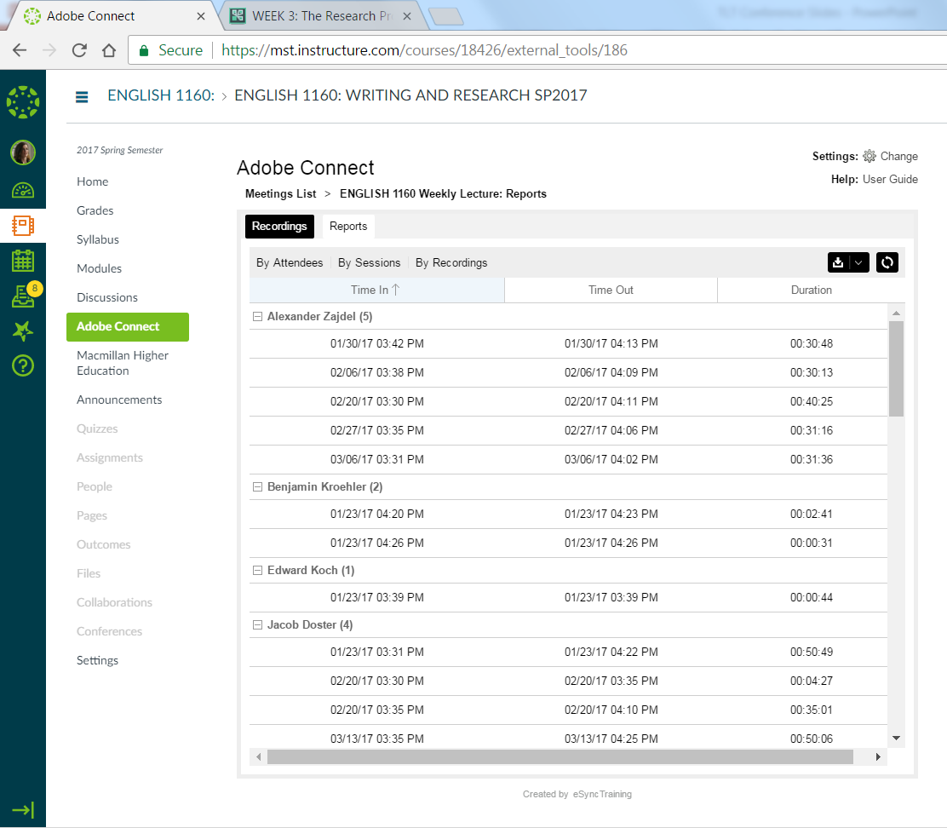

Slide 19
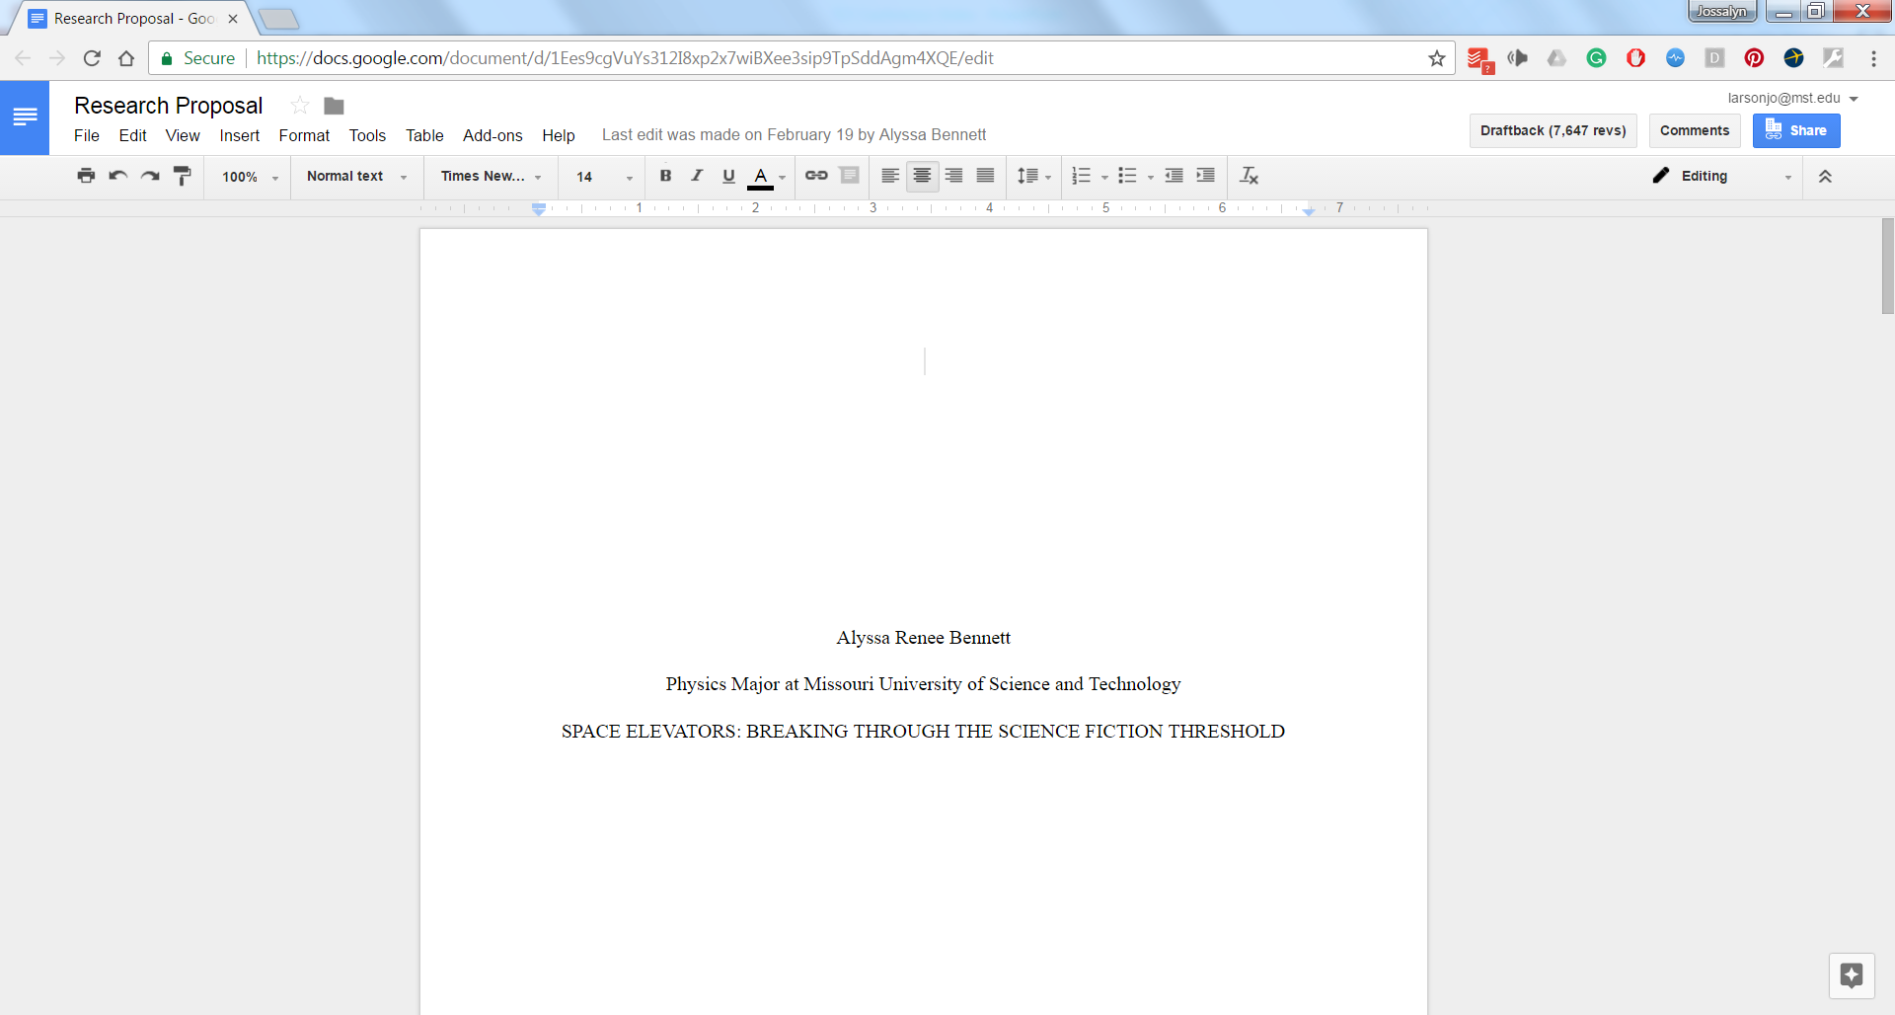

Slide 21
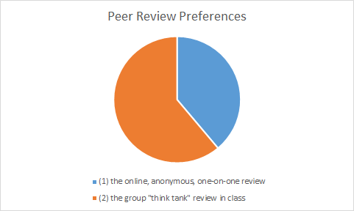

Slide 22
Reactions
The small group format is a great choice. This allows for people in the same fields to have better peer editing experiences. It also allows a more in depth analysis of papers and progress on the days when we must bring in drafts. Having less people in each group means more time spent of each paper, and more time for helpful feedback.

Slide 23
Reactions
I really like the small group setup. It makes the class and following conversation a lot more personal. In a large class I generally wouldn't speak at all but this setting has a few people that I have known for a while know but feel comfortable with

Slide 24
Reactions
Yes the small group made it way easier to put your opinion into the conversation. With less people it is easier to get comfortable and not scared to be the idiot in front of 20-30 but instead 7-10. This alone made it better and the people had similar logic processes to solving the problem.

Slide 25
Reactions
I think I may remember how to sift through scholarly articles with better efficiency as well as the general layout of APA format. I also made a really good friend, so there's that.

